Slide 1

Weather Forecasting using Machine Learning

Slide 2
Overview
Weather forecasting is a multi-billion dollar industry with many applications such as
Transportation
Aviation
Agriculture
Sport & Entertainment
Military
Power Generation
Etc…

Slide 3
Goal
To look at weather forecasting from a data-driven perspective
Use machine learning tools to predict the weather using past two days

Slide 4
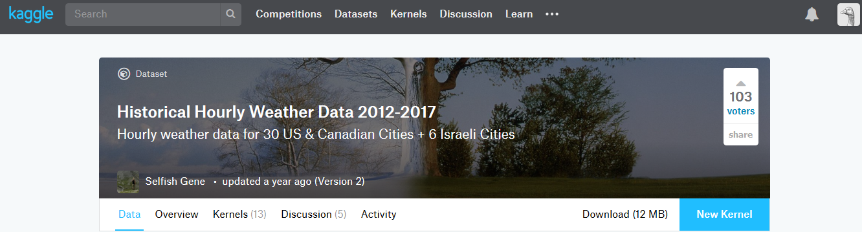
Dataset
Five years (2012 to 2017) of hourly data (temperature, pressure, humidity, wind speed, wind direction)
30 US & Canadian Cities + 6 Israeli Cities
45,000 rows of data
Hourly weather description (sunny, rainy, clear …)
It contains geographical coordinates such as latitude, longitude
Elevation and proximity to water was added later

Slide 5
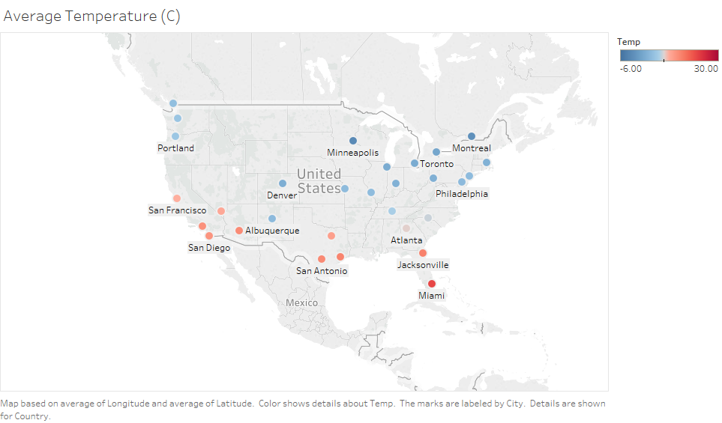
Exploratory Data Analysis

Slide 6
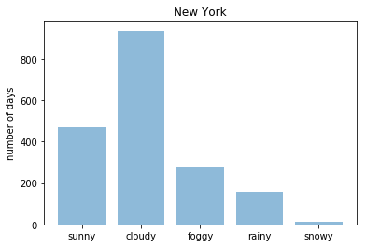
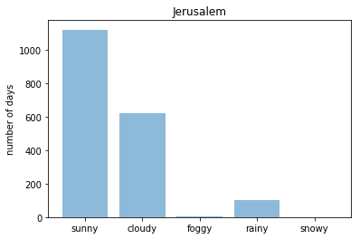
Total: 1850 Days

Slide 7
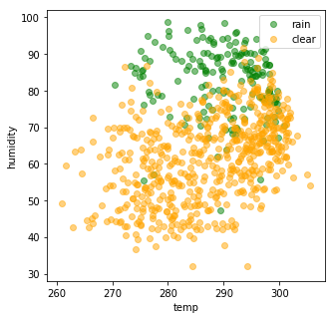
clear vs rainy days
Weather Description Nashville

Slide 8

Approach
Using the data from past two days to predict the weather for the next day!
Time-Series:
 | Temperature | Pressure | Humidity | Wind Speed | Wind Direction | Weather Status
Two days ago | ✔ | ✔ | ✔ | ✔ | ✔ | ✔
Yesterday | ✔ | ✔ | ✔ | ✔ | ✔ | ✔
Today | ? | ? | ? | ? | ? | ?
Scikit Learn Machine Learning Models:
Linear Regression Model is used to predict continuous variables such as temperature
XGBoost Model is used for classification of weather description and wind direction

Slide 9
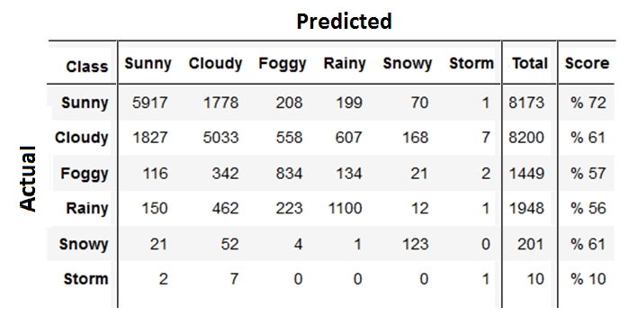
Confusion Matrix

Slide 10
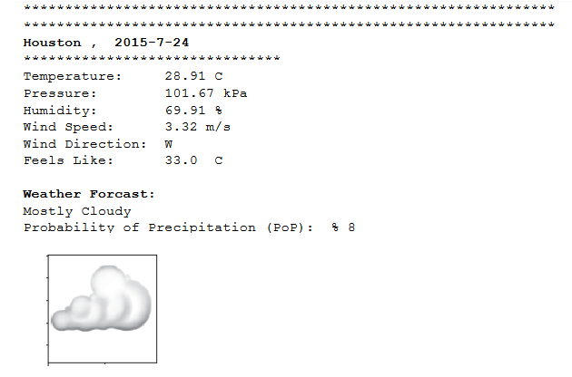
Sample results

Slide 11
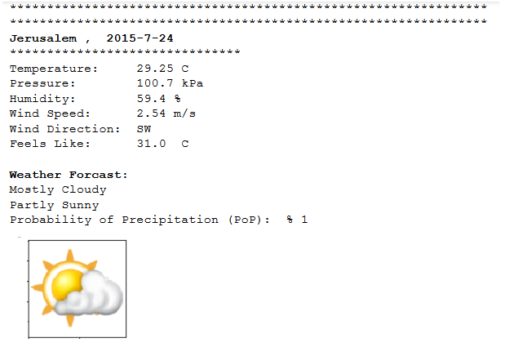

Slide 12
Conclusion
In overall, the model performed well specially for temperature
Other features such as wind speed proved more difficult to predict
For future work it is suggested to use more features and data points from surrounding areas for each city
More historical data points and features such as amount of precipitation, amount of water vapor in atmosphere or pressure difference between a city and the areas around it, could provide better prediction for the user

Slide 13


Slide 14
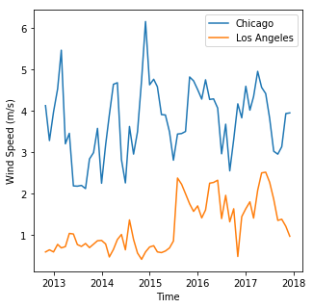
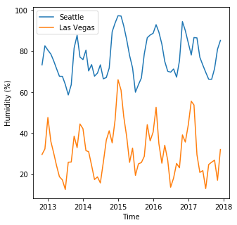

Slide 15
Accuracy Scores
Continuous variables:
Linear Regression, Temperature Score: % 92.96
Linear Regression, Pressure Score: % 77.98
Linear Regression, Humidity Score: % 67.98
Linear Regression, Wind Score: % 40.49
Categorical variables:
XG Boost, Weather Description score: % 67.63
XG Boost, Wind Direction score: % 39.84

Slide 16
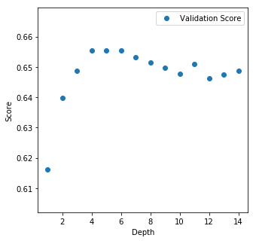
hyper-parameter optimization for XGBoost Model
Best Model: Depth: 5
Accuracy: % 65.55

